Slide 1
Trend Trading
Algorithm
Fall 2019
Joel De La Cruz
Aaron Albiza

Slide 2
Trend Trading
Trend trading is a trading style that attempts to capture gains through analysis of an asset’s momentum in a particular direction.

Slide 3
Trading Signal
A trade signal is a trigger for action, either to buy or sell a security or other asset, generated by analysis.

Slide 4
Big Daddy Rubber Band Expert
1
Summer 2019’s Trend Trading Algorithm

Slide 5
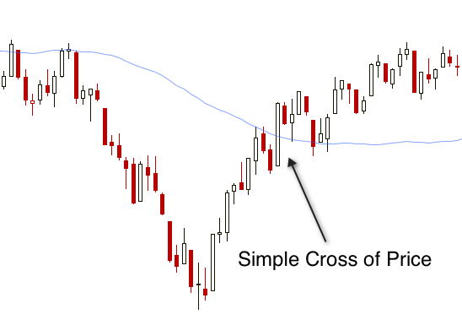
Moving Average
A moving average is an average price for a security using a specified time period.

Slide 6
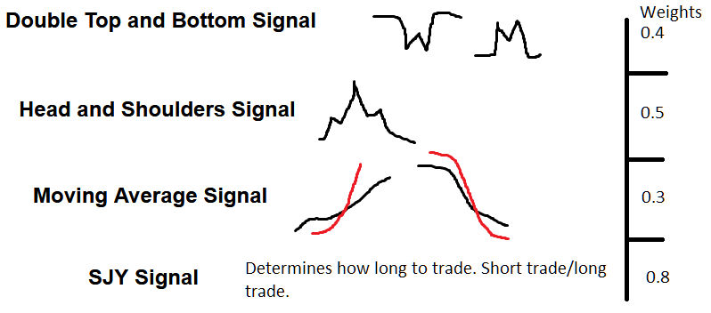
Uses 4 Signals
Head and Shoulders
Predicts and identifies mountain-like shape like shown above. It shows a minor peak, then a minor peak, then a major drop.
Double Top and Bottom
Moving Average
Predicts and identifies W and M shapes on the graph.
Checks if the given moving average is above the current sell price.

Slide 7
Big Daddy Rubber Band Expert
12 months, Profit = $20.52

Slide 8
Analysis
2
Of the Big Daddy Rubber Band Expert

Slide 9

Analysis
The pattern-detecting signals utilize the moving average signal to determine the trend, and predict a pattern from past data.
The simple moving average signal is not an accurate trend-predictor.
This results in inaccurate pattern detection.

Slide 10
Hypothesis
If we improve the trend-detection, we can improve the pattern-prediction and increase profits by accurately predicting where the market will move.

Slide 11
Simple MA Cross
3
Improved

Slide 12
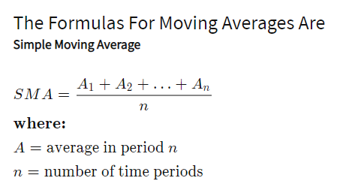
Simple MA Cross
The original Simple MA signal uses a period of 12. This period is stable, but still susceptible to spikes in price.
Changing this period to be 25 means the average line produced will be much more stable and still be a good indicator of the price.

Slide 13

DLC Bullish Cross Signal
4
Bullish Bearish Cross with Simple MA Cross

Slide 14
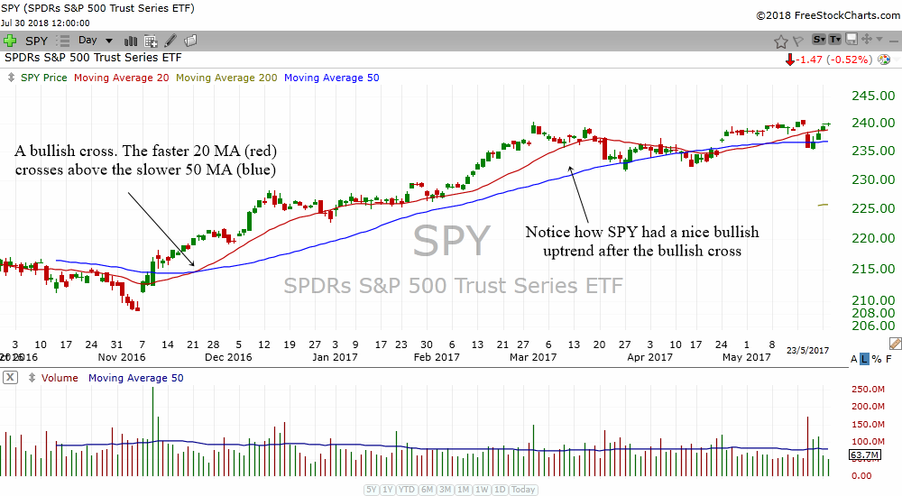
Bullish Cross
A bullish cross happens when a faster-moving average crosses a slower moving average.
A bearish cross is the opposite.
If we supplement the simple moving average signal with a bullish/bearish cross then we increase the trend-prediction accuracy but may reduce sales due to the extra requirements

Slide 15
DLC Bullish Cross
If we supplement the simple moving average signal with a bullish/bearish cross then we increase the trend-prediction accuracy but may reduce sales due to the extra requirements.
Together we can call this a DLC Bullish Cross.

Slide 16
DLC Bullish Cross Signal
12 months, Profit = $841.94

Slide 17
Cash Bull Expert
5
Big Daddy Rubber Band Expert with the DLC Bullish Cross Signal

Slide 18
Moving Average
Bullish/Bearish Cross MA
SJY
Head and Shoulders
Double Top and Bottom
DLC Bullish Cross
Weight - 0.3
Weight - 0.3
Weight - 0.8
Weight - 0.5
Weight - 0.4

Slide 19
Cash Bull Expert
12 months, Profit = $242.80

Slide 20
BigBoiExpert
6
Cash Bull Expert w/ Improved Simple MA Cross

Slide 21
Big Boi Expert
The Big Boi Expert made use of the new DLC Bull and Bear signal while also re-introducing an edited version of the Simple MA Cross signal.
This version gains the benefits of the DLC signal while also having a solid Simple Cross signal with a large period to give it more stability.

Slide 22
Big Boi Expert
12 months, Profit = $349.00

Slide 23

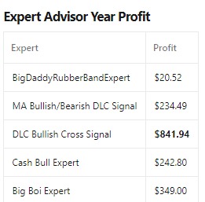
Profit increased by
1601.75%.

Slide 24
THANKS!
Hiring?
You can find us at:
joel@joeldlc.com
albizaaaron@gmail.com

Slide 25
Credits
Special thanks to all the people:
Masoud Sadjadi, Professor and Product Owner
Summer 2019, EFTT team for creating the BigDaddyRubberBandExpert.

